Slide 1
Spark Basics
Chapter 12

Slide 2
Spark Basics
In this chapter you will learn
How to start the Spark Shell
About the SparkContext
Key Concepts of Resilient Distributed Datasets (RDDs)
What are they?
How do you create them?
What operations can you perform with them?
How Spark uses the principles of functional programming

Slide 3
Chapter Topics
Spark Basics
What is Apache Spark?
Using the Spark Shell
RDDs (Resilient Distributed Datasets)
Functional Programming in Spark
Essential Points
Hands-On Exercises

Slide 4

What is Apache Spark?
Apache Spark is a fast, general-pupose engine for large- scale data processing
Written in Scala
Functional programming language that runs in a JVM
Spark Shell
Interactive – for learning or data exploration
Python or Scala
Spark Applications
For large scale data processing
Python, Scala, or Java

Slide 5
Chapter Topics
Spark Basics
What is Apache Spark?
Using the Spark Shell
RDDs (Resilient Distributed Datasets)
Functional Programming in Spark
Essential Points
Hands-On Exercises

Slide 6




Spark Shell
The Spark Shell provides interactive data exploration (REPL)
Writing Spark applications without the shell will be covered later
Python Shell: pyspark Scala Shell: spark-shell
$ spark-shell Welcome to
____ __
/ __/__ ___ _____/ /__
_\ \/ _ \/ _ `/ __/ '_/
/___/ .__/\_,_/_/ /_/\_\ version 1.3.0
/_/
Using Scala version 2.10.4 (Java HotSpot(TM) 64-Bit Server VM, Java 1.7.0_67)
Created spark context..
Spark context available as sc.
SQL context available as sqlContext.
scala>
$ pyspark
Welcome to
____
__
/ __/__ ___ _____/ /__
_\ \/ _ \/ _ `/ __/ '_/
/__ / .__/\_,_/_/ /_/\_\ version 1.3.0
/_/
Using Python version 2.7.8 (default, Aug 27 2015 05:23:36)
SparkContext available as sc, HiveContext available as sqlCtx.
>>>
REPL: Read/Evaluate/Print Loop

Slide 7






Spark Context
Every Spark application requires a Spark Context
– The main entry point to the Spark API
Spark Shell provides a preconfigured Spark Context called sc
Language: Python
Using Python version 2.7.8 (default,
Aug 27 2015 05:23:36)
SparkContext available
>>> sc.appName u'PySparkShell'
as sc, HiveContext
available as sqlCtx.
Language: Scala
…
Spark context available as sc.
SQL context available as sqlContext.
scala> sc.appName
res0: String = Spark shell

Slide 8
Chapter Topics
Spark Basics
What is Apache Spark?
Using the Spark Shell
RDDs (Resilient Distributed Datasets)
Functional Programming in Spark
Essential Points
Hands-On Exercises

Slide 9
RDD (Resilient Distributed Dataset)
RDD (Resilient Distributed Dataset)
Resilient – if data in memory is lost, it can be recreated
Distributed – processed across the cluster
Dataset – initial data can come from a file or be created programmatically
RDDs are the fundamental unit of data in Spark
Most Spark programming consists of performing operations on RDDs

Slide 10
Creating an RDD
Three ways to create an RDD
From a file or set of files
From data in memory
From another RDD
12-10

Slide 11







Example: A File-Based RDD
Language: Scala
File: purplecow.txt
> val mydata = sc.textFile("purplecow.txt")
…
15/01/29 06:20:37 INFO storage.MemoryStore:
Block broadcast_0 memory (estimated MB)
stored as values to
size 151.4 KB, free 296.8
> mydata.count()
RDD: mydata
I've never seen a purple cow. I never hope to see one;
But I can tell you, anyhow, I'd rather see than be one.
…
15/01/29 06:27:37
finished: take 0.160482078 s
INFO spark.SparkContext: Job at <stdin>:1, took
4

Slide 12







RDD Operations
Two types of RDD operations
RDD
value
– Actions – return values
Base RDD
New RDD
– Transformations – define a new RDD based on the current one(s)
Pop quiz:
– Which type of operation is
count()?

Slide 13





RDD Operations: Actions
Some common actions
– count() – return the number of elements
RDD
value
– take(n) – return an array of the first n elements
collect()– return an array of all elements
saveAsTextFile(file) – save to text file(s)
Language: Python
Language: Scala
> mydata = sc.textFile("purplecow.txt")
> val mydata = sc.textFile("purplecow.txt")
> mydata.count() 4
> mydata.count() 4
> for line in mydata.take(2): print line
> for (line <- println(line)
mydata.take(2))
I've never seen I never hope to
a purple cow. see one;
I've never seen I never hope to
a purple cow. see one;

Slide 14




RDD Operations: Transformations
Transformations create a new RDD from an existing one
RDDs are immutable
Data in an RDD is never changed
Transform in sequence to modify the data as needed
Some common transformations
Base RDD
New RDD
map(function) – creates a new RDD by performing a function on each record in the base RDD
filter(function) – creates a new RDD by including or excluding each record in the base RDD according to a Boolean function

Slide 15












Example: map and filter Transformations
Language: Python
I've never seen a purple cow.
I never hope to see one;
But I can tell you, anyhow,
I'd rather see than be one.
Language: Scala
map(lambda line: line.upper())
map(line => line.toUpperCase)
I'VE NEVER SEEN A PURPLE COW. I NEVER HOPE TO SEE ONE;
BUT I CAN TELL YOU, ANYHOW, I'D RATHER SEE THAN BE ONE.
filter(lambda line: line.startswith('I'))
filter(line => line.startsWith('I'))
I'VE NEVER SEEN A PURPLE COW.
I NEVER HOPE TO SEE ONE;
I'D RATHER SEE THAN BE ONE.

Slide 16




Lazy Execution (1)
Data in RDDs is not processed until an action is performed
File: purplecow.txt
Language: Scala
>

Slide 17


Lazy Execution (2)
Data in RDDs is not processed until an action is performed
File: purplecow.txt
Language: Scala
RDD: mydata
> val mydata = sc.textFile("purplecow.txt")

Slide 18


Lazy Execution (3)
Data in RDDs is not processed until an action is performed
File: purplecow.txt
Language: Scala
RDD: mydata
> val mydata = sc.textFile("purplecow.txt")
> val mydata_uc = mydata.map(line => line.toUpperCase())
RDD: mydata_uc

Slide 19
Lazy Execution (4)
Data in RDDs is not processed until an action is performed
File: purplecow.txt
Language: Scala
RDD: mydata
> val mydata = sc.textFile("purplecow.txt")
> val mydata_uc = mydata.map(line => line.toUpperCase())
> val mydata_filt = mydata_uc.filter(line
=> line.startsWith("I"))
RDD: mydata_uc
RDD: mydata_filt

Slide 20


Lazy Execution (5)
Data in RDDs is not processed until an action is performed
File: purplecow.txt
Language: Scala
RDD: mydata
I've never seen a purple cow.
I never hope to see one; But I can tell you, anyhow, I'd rather see than be one.
RDD: mydata_uc
I'VE NEVER SEEN A PURPLE COW.
I NEVER HOPE TO SEE ONE; BUT I CAN TELL YOU, ANYHOW, I'D RATHER SEE THAN BE ONE.
RDD: mydata_filt
I'VE NEVER SEEN A PURPLE COW.
I NEVER HOPE TO SEE ONE; I'D RATHER SEE THAN BE ONE.
> val mydata = sc.textFile("purplecow.txt")
> val mydata_uc = mydata.map(line => line.toUpperCase())
> val mydata_filt = mydata_uc.filter(line
=> line.startsWith("I"))
> mydata_filt.count() 3
12-20

Slide 21


Chaining Transformations (Scala)
Transformations may be chained together
>
>
> mydata_filt = mydata_uc.filter(line => line.startsWith("I"))
> mydata_filt.count() 3
val mydata = sc.textFile("purplecow.txt")
val mydata_uc = mydata.map(line => line.toUpperCase()) val
is exactly equivalent to
> sc.textFile("purplecow.txt").map(line => line.toUpperCase()). filter(line => line.startsWith("I")).count()
3

Slide 22
Chaining Transformations (Python)
Same example in Python
> mydata = sc.textFile("purplecow.txt")
> mydata_uc = mydata.map(lambda s: s.upper())
> mydata_filt = mydata_uc.filter(lambda s: s.startswith('I'))
> mydata_filt.count() 3
is exactly equivalent to
> sc.textFile("purplecow.txt").map(lambda line: line.upper()) \
.filter(lambda line: line.startswith('I')).count()
3

Slide 23


RDD Lineage and toDebugString (Scala)
Spark maintains each RDD’s lineage
– the previous RDDs on which it depends
Use toDebugString to view the lineage of an RDD
> val mydata_filt = sc.textFile("purplecow.txt"). map(line => line.toUpperCase()). filter(line => line.startsWith("I"))
> mydata_filt.toDebugString
(2) FilteredRDD[7] at filter …
File: purplecow.txt
RDD[5]
RDD[6]
RDD[7]
| MappedRDD[6]
| purplecow.txt
| purplecow.txt
at map … MappedRDD[5] … HadoopRDD[4] …

Slide 24


RDD Lineage and toDebugString (Python)
toDebugString output is not displayed as nicely in Python
> mydata_filt.toDebugString()
(1) PythonRDD[8] at RDD at …\n | purplecow.txt MappedRDD[7] at textFile at …[]\n | purplecow.txt HadoopRDD[6] at textFile at …[]
Use print for prettier output
> print mydata_filt.toDebugString()
(1) PythonRDD[8] | at RDD at …
| purplecow.txt | MappedRDD[7] | at textFile at …
| purplecow.txt | HadoopRDD[6] | at textFile at …

Slide 25




Pipelining (1)
When possible, Spark will perform sequences of transformations by row so no data is stored
File: purplecow.txt
I never hope to see one; But I can tell you, anyhow, I'd rather see than be one.
Language: Scala
> val mydata = sc.textFile("purplecow.txt")
> val mydata_uc = mydata.map(line => line.toUpperCase())
> val mydata_filt = mydata_uc.filter(line
=> line.startsWith("I"))
> mydata_filt.take(2)
I've never seen a purple
cow.

Slide 26
Pipelining (2)
When possible, Spark will perform sequences of transformations by row so no data is stored
File: purplecow.txt
I never hope to see one; But I can tell you, anyhow, I'd rather see than be one.
Language: Scala
> val mydata = sc.textFile("purplecow.txt")
> val mydata_uc = mydata.map(line => line.toUpperCase())
> val mydata_filt = mydata_uc.filter(line
=> line.startsWith("I"))
> mydata_filt.take(2)
I'VE NEVER SEEN A PURPLE
COW.

Slide 27
Pipelining (3)
When possible, Spark will perform sequences of transformations by row so no data is stored
File: purplecow.txt
I never hope to see one; But I can tell you, anyhow, I'd rather see than be one.
Language: Scala
> val mydata = sc.textFile("purplecow.txt")
> val mydata_uc = mydata.map(line => line.toUpperCase())
> val mydata_filt = mydata_uc.filter(line
=> line.startsWith("I"))
> mydata_filt.take(2)
I'VE NEVER SEEN A PURPLE
COW.

Slide 28

Pipelining (4)
When possible, Spark will perform sequences of transformations by row so no data is stored
File: purplecow.txt
I never hope to see one; But I can tell you, anyhow, I'd rather see than be one.
Language: Scala
> val mydata = sc.textFile("purplecow.txt")
> val mydata_uc = mydata.map(line => line.toUpperCase())
> val mydata_filt = mydata_uc.filter(line
=> line.startsWith("I"))
> mydata_filt.take(2)
I'VE NEVER SEEN A PURPLE COW.

Slide 29
Pipelining (5)
When possible, Spark will perform sequences of transformations by row so no data is stored
File: purplecow.txt
I've never seen a purple cow.
But I can tell you, anyhow, I'd rather see than be one.
Language: Scala
> val mydata = sc.textFile("purplecow.txt")
> val mydata_uc = mydata.map(line => line.toUpperCase())
> val mydata_filt = mydata_uc.filter(line
=> line.startsWith("I"))
> mydata_filt.take(2)
I never hope to see one;
I'VE NEVER SEEN A PURPLE COW.

Slide 30
Pipelining (6)
When possible, Spark will perform sequences of transformations by row so no data is stored
File: purplecow.txt
I've never seen a purple cow.
But I can tell you, anyhow, I'd rather see than be one.
Language: Scala
> val mydata = sc.textFile("purplecow.txt")
> val mydata_uc = mydata.map(line => line.toUpperCase())
> val mydata_filt = mydata_uc.filter(line
=> line.startsWith("I"))
> mydata_filt.take(2)
I NEVER HOPE TO SEE ONE;
I'VE NEVER SEEN A PURPLE COW.
12-30

Slide 31
Pipelining (7)
When possible, Spark will perform sequences of transformations by row so no data is stored
File: purplecow.txt
I've never seen a purple cow.
But I can tell you, anyhow, I'd rather see than be one.
Language: Scala
> val mydata = sc.textFile("purplecow.txt")
> val mydata_uc = mydata.map(line => line.toUpperCase())
> val mydata_filt = mydata_uc.filter(line
=> line.startsWith("I"))
> mydata_filt.take(2)
I'VE NEVER SEEN A PURPLE COW.
I NEVER HOPE TO SEE ONE;

Slide 32


Pipelining (8)
When possible, Spark will perform sequences of transformations by row so no data is stored
File: purplecow.txt
I've never seen a purple cow.
But I can tell you, anyhow, I'd rather see than be one.
Language: Scala
> val mydata = sc.textFile("purplecow.txt")
> val mydata_uc = mydata.map(line => line.toUpperCase())
> val mydata_filt = mydata_uc.filter(line
=> line.startsWith("I"))
> mydata_filt.take(2)
I'VE NEVER SEEN A PURPLE COW. I NEVER HOPE TO SEE ONE;

Slide 33
Chapter Topics
Spark Basics
What is Apache Spark?
Using the Spark Shell
RDDs (Resilient Distributed Datasets)
Functional Programming in Spark
Essential Points
Hands-On Exercises

Slide 34
Functional Programming in Spark
Spark depends heavily on the concepts of functional programming
Functions are the fundamentalunit of programming
Functions have input and output only
– No state or side effects
Key concepts
Passing functions as input to other functions
Anonymous functions

Slide 35


Passing Functions as Parameters
Many RDD operations take functions as parameters
Pseudocode for the RDD map operation
– Applies function fn to each record in the RDD
RDD {
map(fn(x)) {
foreach record in rdd emit fn(record)
}
}

Slide 36

Example: Passing Named Functions
 | Language: Python
> def toUpper(s): return s.upper() > mydata = sc.textFile("purplecow.txt") > mydata.map(toUpper).take(2)
 | Language: Scala
> def toUpper(s: String): String = { s.toUpperCase } > val mydata = sc.textFile("purplecow.txt") > mydata.map(toUpper).take(2)

Slide 37
Anonymous Functions
Functions defined in-line without an identifier
– Best for short, one-off functions
Supported in many programming languages
Python: lambda
Scala: x => ...
– Java 8: x -> ...
x: ...

Slide 38






Example: Passing Anonymous Functions
Python:
> mydata.map(lambda line: line.upper()).take(2)
Scala:
> mydata.map(line => line.toUpperCase()).take(2)
OR
> mydata.map(_.toUpperCase()).take(2)
Scala allows anonymous parameters using underscore (_)

Slide 39




Example: Java
...
JavaRDD<String> lines = sc.textFile("file");
JavaRDD<String> lines_uc = lines.map( new MapFunction<String, String>() { public String call(String line) {
return line.toUpperCase();
}
});
...
Java 7
...
JavaRDD<String> lines = sc.textFile("file");
JavaRDD<String> lines_uc = lines.map( line -> line.toUpperCase());
...
Java 8

Slide 40
Chapter Topics
Spark Basics
What is Apache Spark?
Using the Spark Shell
RDDs (Resilient Distributed Datasets)
Functional Programming in Spark
Essential Points
Hands-On Exercises
12-40

Slide 41
Essential Points
Spark can be used interactively via the Spark Shell
Python or Scala
Writing non-interactive Spark applications will be covered later
RDDs (Resilient Distributed Datasets) are a key concept in Spark
RDD Operations
Transformations create a new RDD based on an existing one
Actions return a value from an RDD
Lazy Execution
Transformations are not executed until required by an action
Spark uses functional programming
Passing functions as parameters
Anonymous functions in supported languages (Python and Scala)

Slide 42
Chapter Topics
Spark Basics
What is Apache Spark?
Using the Spark Shell
RDDs (Resilient Distributed Datasets)
Functional Programming in Spark
Essential Points
Hands-On Exercises

Slide 43
Introduction to Exercises: Getting Started
Instructions are in the Hands-On Exercise Manual
Start with
General Notes
Setting Up

Slide 44
Introduction to Exercises: Pick Your Language
Your choice: Python or Scala
For most exercises in this course, you may choose to work with either Python or Scala
Solution and example files
.pyspark – Python shell commands
.scalaspark – Scala shell commands
.py – complete Python Spark applications
.scala – complete Scala Spark applications

Slide 45
Introduction to Exercises: Classroom Virtual Machine
Your virtual machine
Log in as user training (password training)
Pre-installed and configured with
Spark and CDH (Cloudera’s Distribution, including Apache Hadoop)
Various tools including Emacs, IntelliJ, and Maven
Training materials: ~/training_materials/sparkdev folder on the VM
data – sample datasets uses in exercises
examples – all the example code in this course
solutions – solutions for Scala Shell and Python exercises
stubs – starter code required in some exercises

Slide 46
Introduction to Exercises: The Data
Most exercises are based around a hypothetical company: Loudacre Mobile
A cellular telephone company
Loudacre Mobile Customer Support has many sources of data they need to process, transform and analyze
Customer account data
Web server logs from Loudacre’s customer support website
New device activation records
Customer support Knowledge Base articles
Information about models of supported devices
L udacre
o
mobile

Slide 47
Hands-On Exercises
Now, please do the following three Hands-On Exercises
View the Spark Documentation
Familiarize yourself with the Spark documentation; you will refer to this documentation frequently during the course
Use the Spark Shell
Follow the instructionsfor either the Python or Scala shell
Use RDDs to Transform a Dataset
Use either the Python or Scala Spark Shell to explore the Loudacre weblogs
Please refer to the Hands-On Exercise Manual
To turn down the logging level run the following command:
sudo gedit /etc/spark/conf/log4j.properties
edit the second line to match:
log4j.rootCategory=ERROR, console

Slide 48
Working With RDDs and DataFrames
Chapter 13

Slide 49
Working With RDDs
In this chapter you will learn
How RDDs are created from files or data in memory
How to handle file formats with multi-line records
How to use some additional operations on RDDs
How to create DataFrames
Operations on DataFrames
13-2

Slide 50
Chapter Topics
Working With RDDs in Spark
Creating RDDs
Other General RDD Operations
Essential Points
Hands-On Exercise: Process Data Files with Spark

Slide 51
RDDs
RDDs can hold any type of element
Primitive types: integers, characters, booleans, and so on.
Sequence types: strings, lists, arrays, tuples, dicts, and so on. (including nested data types)
Scala/Java Objects (if serializable)
Mixed types
Some types of RDDs have additional functionality
Pair RDDs
RDDs consisting of Key-Value pairs
Double RDDs
RDDs consisting of numeric data

Slide 52


Creating RDDs From Collections
You can create RDDs from collections instead of files
– sc.parallelize(collection)
> myData = ["Alice","Carlos","Frank","Barbara"]
> myRdd = sc.parallelize(myData)
> myRdd.take(2) ['Alice', 'Carlos']
Useful when
Testing
Generating data programmatically
Integrating

Slide 53
Creating RDDs from Files (1)
For file-based RDDs, use SparkContext.textFile
Accepts a single file, a wildcard list of files, or a comma-separated list of files
Examples
sc.textFile("myfile.txt")
sc.textFile("mydata/*.log")
sc.textFile("myfile1.txt,myfile2.txt")
Each line in the file(s) is a separate record in the RDD
Files are referenced by absolute or relative URI
Absolute URI:
file:/home/training/myfile.txt
hdfs://localhost/loudacre/myfile.txt
Relative URI (uses default file system): myfile.txt

Slide 54





Creating RDDs from Files (2)
textFile maps each line in a file to a separate RDD element
I've never seen a purple cow. \n
I never hope to see one; \n But I can tell you, anyhow, \n I'd rather see than be one. \n
textFile only works with line-delimited text files
What about other formats?
I've never seen a purple cow.
I never hope to see one;
But I can tell you, anyhow,
I'd rather see than be one.

Slide 55
Input and Output Formats (1)
Spark uses Hadoop InputFormat and OutputFormat Java classes
Some examples from core Hadoop
TextInputFormat / TextOutputFormat – newline delimited text files
SequenceInputFormat / SequenceOutputFormat
FixedLengthInputFormat
Many implementations available in additional libraries
Such as AvroInputFormat / AvroOutputFormat in the Avro library

Slide 56
Input and Output Formats (2)
Specify any input format using sc.hadoopFile
or newAPIhadoopFile for New API classes
Specify any output format using rdd.saveAsHadoopFile
or saveAsNewAPIhadoopFile for New API classes
textFile and saveAsTextFile are convenience functions
textFile just calls hadoopFile specifying TextInputFormat
saveAsTextFile calls saveAsHadoopFile specifying
TextOutputFormat

Slide 57








Whole File-Based RDDs (1)
sc.textFile maps each line in a file to a separate RDD element
What about files with a multi-line input format like XML or JSON?
sc.wholeTextFiles(directory)
Maps entire contents of each file in a directory to a single RDD element
Works only for small files (element must fit in memory)
file1.json
file2.json
(file1.json,{"firstName":"Fred","lastName":"Flintstone","userid":"123"} )
(file2.json,{"firstName":"Barney","lastName":"Rubble","userid”:"234"} ) (file3.xml,… )
(file4.xml,… )
13-10

Slide 58



Whole File-Based RDDs (2)
Language: Python
> import json
> myrdd1 = sc.wholeTextFiles(mydir)
> myrdd2 = myrdd1
.map(lambda (fname,s): json.loads(s))
> for record in myrdd2.take(2):
> print record["firstName"]
Output:
Fred Barney
Language: Scala
> import scala.util.parsing.json.JSON
> val myrdd1 = sc.wholeTextFiles(mydir)
> val myrdd2 = myrdd1
.map(pair => JSON.parseFull(pair._2).get. asInstanceOf[Map[String,String]])
> for (record <- myrdd2.take(2)) println(record.getOrElse("firstName",null))

Slide 59
Chapter Topics
Working With RDDs in Spark
Creating RDDs
Other General RDD Operations
Essential Points
Hands-On Exercise: Process Data Files with Spark

Slide 60
Some Other General RDD Operations
Single-RDD Transformations
flatMap – maps one element in the base RDD to multiple elements
distinct – filter out duplicates
sortBy – use provided function to sort
Multi-RDD Transformations
intersection – create a new RDD with all elements in both original RDDs
union – add all elements of two RDDs into a single new RDD
zip – pair each element of the first RDD with the corresponding element of the second

Slide 61




Example: flatMap and distinct
> sc.textFile(file).
flatMap(line => line.split(' ')). | L | anguage: Scala
distinct()
I’ve never seen a purple cow
I
never hope to
…
I’ve
never
seen
a
purple
cow
I
hope
to
…
I’ve never seen a purple cow.
I never hope to see one;
But I can tell you, anyhow,
I’d rather see than be one.

Slide 62



Examples: Multi-RDD Transformations
rdd1.union(rdd2)
rdd1
Chicago
Boston
Paris
San Francisco
Tokyo
rdd2
San Francisco
Boston
Amsterdam
Mumbai
McMurdo Station
Chicago
Boston
Paris
San Francisco
Tokyo
San Francisco
Boston
Amsterdam
Mumbai
McMurdo Station
rdd1.subtract(rdd2)
rdd1.zip(rdd2)
Tokyo
Paris
Chicago
(Chicago,San Francisco)
(Boston,Boston)
(Paris,Amsterdam)
(San Francisco,Mumbai)
(Tokyo,McMurdo Station)

Slide 63
Some Other General RDD Operations
Other RDD operations
first – return the first element of the RDD
foreach – apply a function to each element in an RDD
top(n) – return the largest n elements using natural ordering
Sampling operations
sample – create a new RDD with a sampling of elements
takeSample – return an array of sampled elements
Double RDD operations
Statistical functions, for example, mean, sum, variance, stdev

Slide 64
Chapter Topics
Working With RDDs in Spark
Creating RDDs
Other General RDD Operations
Essential Points
Hands-On Exercise: Process Data Files with Spark

Slide 65
Essential Points
RDDs can be created from files, parallelized data in memory, or other RDDs
sc.textFile reads newline delimited text, one line per RDD record
sc.wholeTextFile reads entire files into single RDD records
Generic RDDs can consist of any type of data
Generic RDDs provide a wide range of transformation operations

Slide 66
Chapter Topics
Working With RDDs in Spark
Creating RDDs
Other General RDD Operations
Essential Points
Hands-On Exercise: Process Data Files with Spark

Slide 67
Hands-On Exercise: Process Data Files with Spark
In this exercise you will
Process a set of XML files using wholeTextFiles
Reformat a dataset to standardize format (bonus)
Please refer to the Hands-On Exercise Manual
13-20

Slide 68
Spark SQL
Chapter 14

Slide 69
DataFrames and Spark SQL
In this chapter you will learn
What Spark SQL is
What features the DataFrame API provides
How to create a SQLContext
How to load existing data into a DataFrame
How to query data in a DataFrame
How to convert from DataFrames to Pair RDDs

Slide 70
Chapter Topics
Spark SQL and DataFrames
Spark SQL and the SQL Context
Creating DataFrames
Transforming and Querying DataFrames
Saving DataFrames
DataFrames and RDDs
Comparing Spark SQL, Impala, and Hive-on-Spark
Essential Points
Hands-On Exercise: Use Spark SQL for ETL

Slide 71
What is Spark SQL?
What is Spark SQL?
Spark module for structured data processing
Replaces Shark (a prior Spark module, now deprecated)
Built on top of core Spark
What does Spark SQL provide?
The DataFrame API – a library for working with data as tables
Defines DataFrames containing Rows and Columns
DataFrames are the focus of this chapter
Catalyst Optimizer – an extensible optimization framework
A SQL Engine and command line interface
Notes:
Spark SQL provides functions for manipulating large sets of distributed, structured data using an SQL subset supported by Spark and Hive SQL (HQL). With DataFrames introduced in Spark 1.3, which simplified handling of structured data and enabled radical performance optimizations, Spark SQL became one of the most important Spark components. Spark SQL can also be used for reading and writing data to and from various structured formats and data sources, such as JavaScript Object Notation (JSON) files, Parquet files (an increasingly popular file format that allows for storing schema along with the data), relational databases, Hive, and others. Operations on DataFrames at some point translate to operations on RDDs and execute as ordinary Spark jobs. Spark SQL provides a query optimization framework called Catalyst that can be extended by custom optimization rules. Spark SQL also includes a Thrift server, which can be used by external systems, such as business intelligence tools, to query data through Spark SQL using classic JDBC and ODBC protocols.

Slide 72
SQL Context
The main Spark SQL entry point is a SQL Context object
Requires a SparkContext
The SQL Context in Spark SQL is similar to Spark Context in core Spark
There are two implementations
SQLContext
basic implementation
HiveContext
Reads and writes Hive/HCatalog tables directly
Supports full HiveQL language
Requires the Spark application be linked with Hive libraries
Recommended starting with Spark 1.5

Slide 73



Creating a SQL Context
SQLContext is created based on the SparkContext
Language: Scala
import org.apache.spark.sql.SQLContext val sqlCtx = new SQLContext(sc)
import sqlCtx._

Slide 74
Chapter Topics
Spark SQL and DataFrames
Spark SQL and the SQL Context
Creating DataFrames
Transforming and Querying DataFrames
Saving DataFrames
DataFrames and RDDs
Comparing Spark SQL, Impala, and Hive-on-Spark
Essential Points
Hands-On Exercise: Use Spark SQL for ETL

Slide 75
DataFrames
DataFrames are the main abstraction in Spark SQL
Analogous to RDDs in core Spark
A distributed collection of data organized intonamed columns
Built on a base RDD containing Row objects

Slide 76
Creating DataFrames
DataFrames can be created
From an existing structured datasource (such as a file in Parquet or JSON format)
From an existing RDD
By performing an operation or query on another DataFrame
By programmatically defining a schema

Slide 77


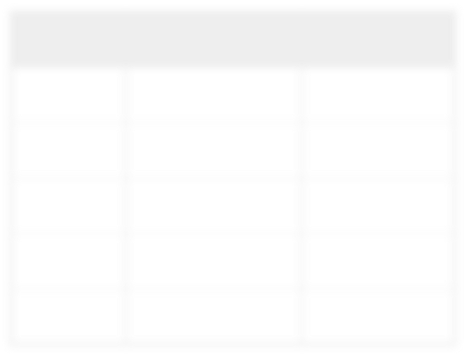



Example: Creating a DataFrame from a JSON File
val sqlCtx = new SQLContext(sc) import sqlCtx._
val peopleDF = sqlCtx.jsonFile("people.json")
age | name | pcode
null | Alice | 94304
30 | Brayden | 94304
19 | Carla | 10036
46 | Diana | null
null | Étienne | 94104
File: people.json
{"name":"Alice",
"pcode":"94304"}
{"name":"Brayden", "age":30, "pcode":"94304"}
{"name":"Carla",
{"name":"Diana",
"age":19, "pcode":"10036"} "age":46}
{"name":"Étienne",
"pcode":"94104"}
20-10

Slide 78
Creating a DataFrame from a Data Source
Methods on the SQLContext object
Convenience functions
jsonFile(filename)
parquetFile(filename)
Generic base function: load
load(filename,source) – load filename of type source
(default Parquet)
load(source,options…)– load from a source of type source
using options
Convenience functions are implemented by calling load
– jsonFile("people.json") = load("people.json", "json")

Slide 79
Data Sources
Spark SQL 1.3 includes three data source types
json
parquet
jdbc
You can also use third party data source libraries, such as
Avro
HBase
CSV
MySQL
and more being added all the time

Slide 80




Generic Load Function Example: JDBC
Example: Loading from a MySQL database
Language: Python
accountsDF = sqlCtx.load(source="jdbc", \ url="jdbc:mysql://dbhost/dbname?user=…&password=…", \
dbtable="accounts")
Language: Scala
val accountsDF = sqlCtx.load("jdbc",
Map("url"-> "jdbc:mysql://dbhost/dbname?user=…&password=…",
"dbtable" -> "accounts"))
Warning: Avoid direct access to databases in production environments, which may overload the DB or be interpreted as service attacks
Use Sqoop to import instead

Slide 81



Generic Load Function Example: Third-party or Custom Sources
You can also use custom or third party data sources
Example: Read from an Avro file using the avro source in the Databricks Spark Avro package
Language: Python
$ spark-shell --packages com.databricks:spark-avro_2.10:1.0.0
> …
> val myDF = sqlCtx.load("myfile.avro","com.databricks.spark.avro")
Language: Scala
$ pyspark --packages com.databricks:spark-avro_2.10:1.0.0
> …
> myDF = sqlCtx.load("myfile.avro","com.databricks.spark.avro")

Slide 82
Chapter Topics
Spark SQL and DataFrames
Spark SQL and the SQL Context
Creating DataFrames
Transforming and Querying DataFrames
Saving DataFrames
DataFrames and RDDs
Comparing Spark SQL, Impala, and Hive-on-Spark
Essential Points
Hands-On Exercise: Use Spark SQL for ETL

Slide 83
DataFrame Basic Operations (1)
Basic Operations deal with DataFrame metadata (rather than its data)
schema – returns a schema object describing the data
printSchema – displays the schema as a visual tree
cache / persist – persists the DataFrame to disk or memory
columns – returns an array containing the names of the columns
dtypes – returns an array of (column-name,type) pairs
explain – prints debug information aboutthe DataFrame to the console

Slide 84




DataFrame Basic Operations (2)
Example: Displaying column data types using dtypes
Language: Python
> peopleDF = sqlCtx.jsonFile("people.json")
> for item in peopleDF.dtypes(): print item
('age', 'bigint')
('name', 'string')
('pcode', 'string’)
Language: Scala
> val peopleDF = sqlCtx.jsonFile("people.json")
> peopleDF.dtypes.foreach(println)
(age,LongType) (name,StringType) (pcode,StringType)

Slide 85
Working with Data in a DataFrame
Queries – create a new DataFrame
DataFrames are immutable
Queries are analogous to RDD transformations
Actions – return data to the Driver
Actions trigger “lazy” execution of queries

Slide 86

DataFrame Actions
Some DataFrame actions
collect – return all rows as an array of Row objects
take(n) – return the first n rows as an array of Row objects
count – return the number of rows
show(n) – display the first n rows (default=20)
Language: Scala
> peopleDF.count() res7: Long = 5
> peopleDF.show(3) age name pcode null Alice 94304
30 Brayden 94304
19 Carla 10036

Slide 87
DataFrame Queries (1)
DataFrame query methods return new DataFrames
Queries can be chained like transformations
Some query methods
distinct: returns a new DataFrame with distinct elements of this DF
join: joins this DataFrame with a second DataFrame
– Several variants for inside, outside, left, right, and so on
limit: a new DF with the first n rows of this DataFrame
select: a new DataFrame with data from one or more columns of the base DataFrame
filter: a new DataFrame with rows meeting a specified condition
20-20

Slide 88
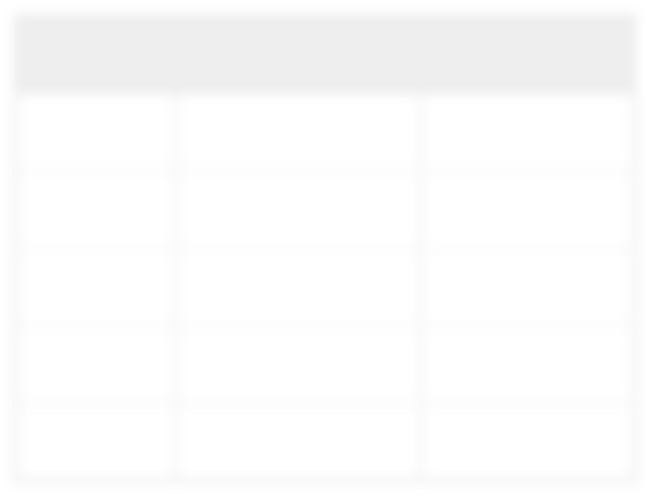





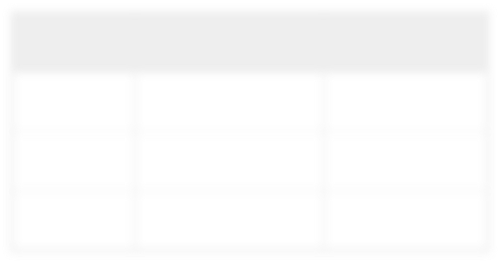
DataFrame Queries (2)
Example: A basic query with limit
age | name | pcode
null | Alice | 94304
30 | Brayden | 94304
19 | Carla | 10036
46 | Diana | null
null | Étienne | 94104
Language: Scala
> peopleDF.limit(3).show
age name pcode null Alice 94304
30 Brayden 94304
19 Carla 10036
Output of show
age | name | pcode
null | Alice | 94304
30 | Brayden | 94304
19 | Carla | 10036

Slide 89



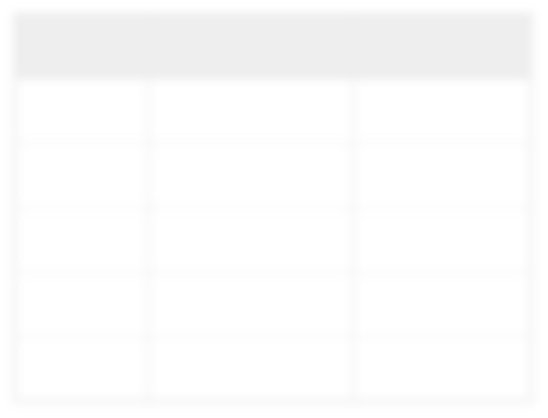




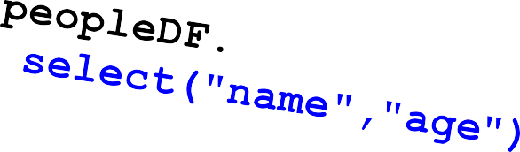
DataFrame Query Strings (1)
Some query operations take strings containing simple query expressions
– Such as select and where
Example: select
age name pcode null Alice 94304
30 Brayden 94304
19 Carla 10036
46 Diana null null Étienne 94104
age
null
30
19
46
null
name
age
Alice
null
Brayden
30
Carla
19
Diana
46
Étienne
null

Slide 90


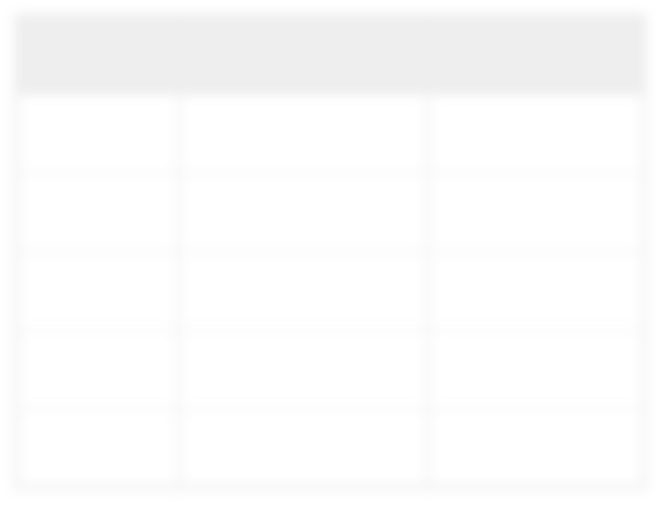

DataFrame Query Strings (2)
Example: where
peopleDF. where("age > 21")
age | name | pcode
null | Alice | 94304
30 | Brayden | 94304
19 | Carla | 10036
46 | Diana | null
null | Étienne | 94104
age | name | pcode
30 | Brayden | 94304
46 | Diana | null

Slide 91
Querying DataFrames using Columns (1)
Some DF queries take one or more columns or column expressions
Required for more sophisticated operations
Some examples
select
sort
join
where

Slide 92

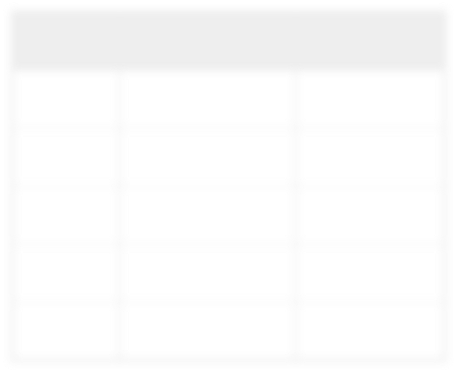






Querying DataFrames using Columns (2)
In Python, reference columns by name using dot notation
ageDF = peopleDF.select(peopleDF.age)
age | name | pcode
null | Alice | 94304
30 | Brayden | 94304
19 | Carla | 10036
46 | Diana | null
null | Étienne | 94104
In Scala, columns can be referenced in two ways
val ageDF = peopleDF.select($"age")
– OR
val ageDF = peopleDF.select(peopleDF("age"))
age
null
30
19
46
null

Slide 93
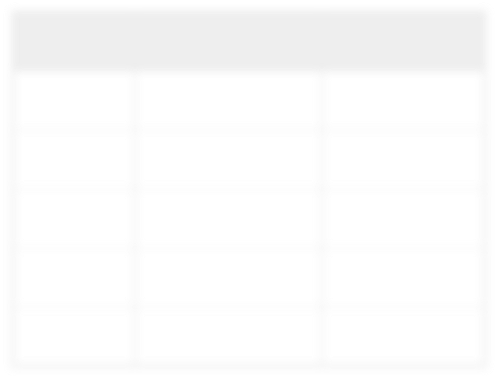
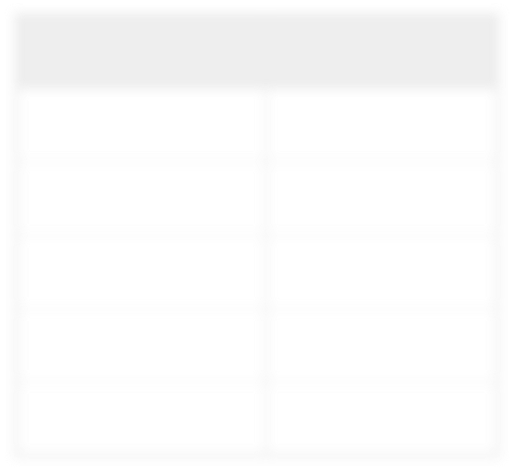
Querying DataFrames using Columns (3)
Column references can also be column expressions
Language: Python
peopleDF.select(peopleDF.name,peopleDF.age+10)
Language: Scala
peopleDF.select(peopleDF("name"),peopleDF("age")+10)
age | name | pcode
null | Alice | 94304
30 | Brayden | 94304
19 | Carla | 10036
46 | Diana | null
null | Étienne | 94104
name | age+10
Alice | null
Brayden | 40
Carla | 29
Diana | 56
Étienne | null

Slide 94




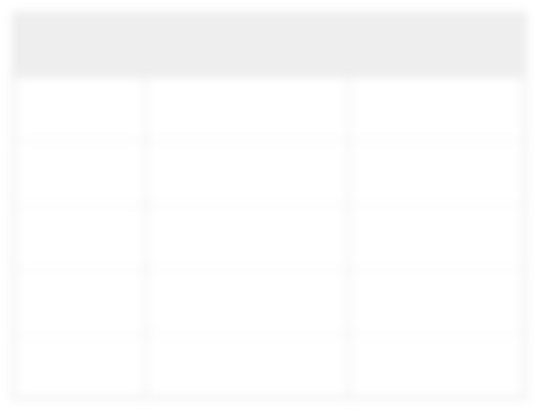
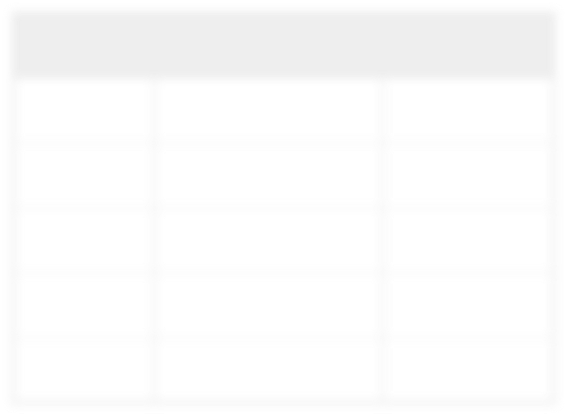


Querying DataFrames using Columns (4)
Example: sorting by columns (descending)
 | Language: Python
peopleDF.sort(peopleDF.age.desc())
.asc and .desc are column expression methods used with sort
 | Language: Scala
peopleDF.sort(peopleDF("age").desc)
age | name | pcode
null | Alice | 94304
30 | Brayden | 94304
19 | Carla | 10036
46 | Diana | null
null | Étienne | 94104
age | name | pcode
46 | Diana | null
30 | Brayden | 94304
19 | Carla | 10036
null | Alice | 94304
null | Étienne | 94104

Slide 95

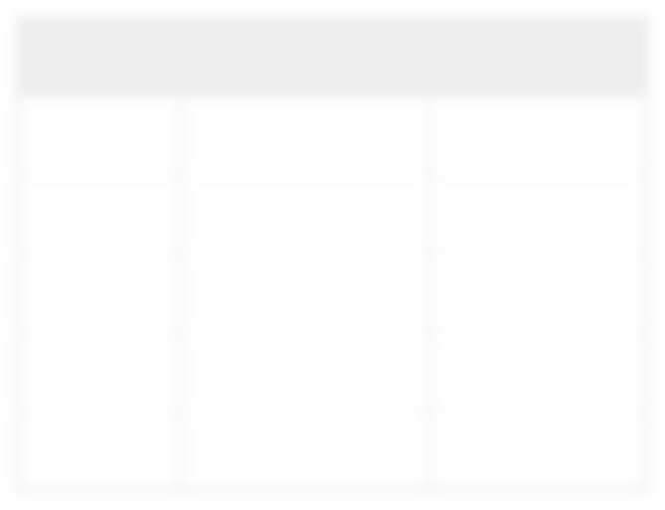

SQL Queries
Spark SQL also supports the ability to perform SQL queries
– First, register the DataFrame as a “table” with the SQL Context
peopleDF.registerTempTable("people")
sqlCtx.sql("""SELECT * FROM people WHERE name LIKE "A%" """)
age | name | pcode
null | Alice | 94304
30 | Brayden | 94304
19 | Carla | 10036
46 | Diana | null
null | Étienne | 94104
age | name | pcode
null | Alice | 94304

Slide 96
Chapter Topics
Spark SQL and DataFrames
Spark SQL and the SQL Context
Creating DataFrames
Transforming and Querying DataFrames
Saving DataFrames
DataFrames and RDDs
Comparing Spark SQL, Impala, and Hive-on-Spark
Essential Points
Hands-On Exercise: Use Spark SQL for ETL

Slide 97
Saving DataFrames
Data in DataFrames can be saved to a data source
Built in support for JDBC and Parquet File
createJDBCTable: create a new table in a database
insertInto: save to an existing table in a database
saveAsParquetFile: save as a Parquet file (including schema)
saveAsTable: save as a Hive table (HiveContext only)
Can also use third party and custom data sources
save: generic base function
20-30

Slide 98
Chapter Topics
Spark SQL and DataFrames
Spark SQL and the SQL Context
Creating DataFrames
Transforming and Querying DataFrames
Saving DataFrames
DataFrames and RDDs
Comparing Spark SQL, Impala, and Hive-on-Spark
Essential Points
Hands-On Exercise: Use Spark SQL for ETL

Slide 99


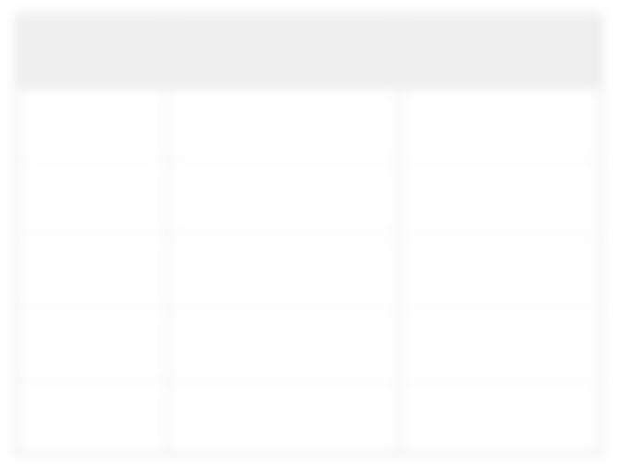

DataFrames and RDDs (1)
DataFrames are built on RDDs
Base RDDs contain Row objects
Use rdd to get the underlying RDD
peopleRDD = peopleDF.rdd
peopleDF
peopleRDD
age | name | pcode
null | Alice | 94304
30 | Brayden | 94304
19 | Carla | 10036
46 | Diana | null
null | Étienne | 94104
Row[null,Alice,94304]
Row[30,Brayden,94304]
Row[19,Carla,10036]
Row[46,Diana,null]
Row[null,Étienne,94104]

Slide 100
DataFrames and RDDs (2)
Row RDDs have all the standard Spark actions and transformations
Actions – collect, take, count, and so on
Transformations – map, flatMap, filter, and so on
Row RDDs can be transformed into PairRDDs to use map-reduce methods

Slide 101
Working with Row Objects
The syntax for extracting data from rows depends on language
Python
Column names are object attributes
row.age – return age column value from row
Scala
Use Array-like syntax
row(0) – returns element in the first column
row(1) – return element in the second column
etc.
Use type-specific get methods to return typed values
row.getString(n) – returns n^{th} column as a String
row.getInt(n) – returns n^{th} column as an Integer
etc.

Slide 102








Example: Extracting Data from Rows
Row[null,Alice,94304]
Row[30,Brayden,94304]
Row[19,Carla,10036]
Row[46,Diana,null]
Row[null,Étienne,94104]
Extract data from Rows
Language: Scala
val peopleRDD = peopleByPCode =
peopleDF.rdd peopleRDD.
map(row => (row(2),row(1))). groupByKey())
(94304,Alice)
(94304,Brayden)
(10036,Carla)
(null,Diana)
(94104,Étienne)
(null,[Diana])
(94304,[Alice,Brayden])
(10036,[Carla])
(94104,[Étienne])

Slide 103
Converting RDDs to DataFrames
You can also create a DataFrame from an RDD
– sqlCtx.createDataFrame(rdd)

Slide 104
Chapter Topics
Spark SQL and DataFrames
Spark SQL and the SQL Context
Creating DataFrames
Transforming and Querying DataFrames
Saving DataFrames
DataFrames and RDDs
Comparing Spark SQL, Impala, and Hive-on-Spark
Essential Points
Hands-On Exercise: Use Spark SQL for ETL

Slide 105

Comparing Spark SQL with Impala
Spark SQL is built on Spark, a general purpose processing engine
Provides convenient SQL-like access to structured data in a Spark application
Impala is a specialized SQL engine
Much better performance for querying
Much more mature than Spark SQL
Robust security via Sentry
Impala is better for
Interactive queries
Data analysis
Use Spark SQL for
ETL
Access to structured data required by a Spark application

Slide 106


Comparing Spark SQL with Hive on Spark
Spark SQL
Provides the DataFrame API to allow structured data processing in a Spark application
Programmers can mix SQL with procedural processing
Hive-on-Spark
Hive provides a SQL abstraction layer over MapReduce or Spark
Allows non-programmers to analyze data using familiar SQL
Hive-on-Spark replaces MapReduce as the engine underlying Hive
Does not affect the user experience of Hive
Except many times faster queries!

Slide 107
Chapter Topics
Spark SQL and DataFrames
Spark SQL and the SQL Context
Creating DataFrames
Transforming and Querying DataFrames
Saving DataFrames
DataFrames and RDDs
Comparing Spark SQL, Impala, and Hive-on-Spark
Essential Points
Hands-On Exercise: Use Spark SQL for ETL
20-40

Slide 108
Essential Points
Spark SQL is a Spark API for handling structured and semi-structured data
Entry point is a SQLContext
DataFrames are the key unit of data
DataFrames are based on an underlying RDD of Row objects
DataFrames query methods return new DataFrames; similar to RDD transformations
The full Spark API can be used with Spark SQL Data by accessing the underlying RDD
Spark SQL is not a replacement for a database, or a specialized SQL engine like Impala
– Spark SQL is most useful for ETL or incorporating structured datainto other applications

Slide 109
Chapter Topics
Spark SQL and DataFrames
Spark SQL and the SQL Context
Creating DataFrames
Transforming and Querying DataFrames
Saving DataFrames
DataFrames and RDDs
Comparing Spark SQL, Impala, and Hive-on-Spark
Essential Points
Hands-On Exercise: Use Spark SQL for ETL

Slide 110
Hands-On Exercise: Use Spark SQL for ETL
In this exercise you will
Import data from MySQL
Use Spark to normalize the data
Save the data to Parquet format
Please refer to the Hands-On Exercise Manual

Slide 111
Aggregating Data
Chapter 15

Slide 112
Aggregating Data with Pair RDDs
In this chapter you will learn
How to create Pair RDDs of key-value pairs from generic RDDs
Special operations available on Pair RDDs
How map-reduce algorithms are implemented in Spark
14-2

Slide 113
Chapter Topics
Aggregating Data with Pair RDDs
Key-Value Pair RDDs
Map-Reduce
Other Pair RDD Operations
Essential Points
Hands-On Exercise: Use Pair RDDs to Join Two Datasets

Slide 114

Pair RDDs
Pair RDDs are a special form of RDD
Each element must be a key-value pair (a two-element tuple)
Keys and values can be any type
Why?
Use with Map-reduce algorithms
Many additional functions are available for common data processing needs
– e.g., sorting, joining, grouping, counting, etc.
Pair RDD
(key1,value1)
(key2,value2)
(key3,value3)
…

Slide 115
Creating Pair RDDs
The first step in most workflows is to get the data into key/value form
What should the RDD should be keyed on?
What is the value?
Commonly used functions to create Pair RDDs
map
flatMap / flatMapValues
keyBy

Slide 116






Example: A Simple Pair RDD
Example: Create a Pair RDD from a tab-separated file
map(fields => (fields(0),fields(1)))
> | val users = | sc.textFile(file).
 | map(line => | line.split('\t').
(user001,Fred Flintstone)
(user090,Bugs Bunny)
(user111,Harry Potter)
…
user001\tFred user090\tBugs user111\tHarry
…
Flintstone Bunny Potter

Slide 117









Example: Keying Web Logs by User ID
Language: Python
> sc.textFile(logfile) \
.keyBy(lambda line: line.split(' ')[2])
Language: Scala
> sc.textFile(logfile).
keyBy(line => line.split(' ')(2))
User ID
56.38.234.188 –
56.38.234.188 –
203.146.17.59 –
…
99788 "GET /KBDOC-00157.html HTTP/1.0" …
99788 "GET /theme.css HTTP/1.0" …
25254 "GET /KBDOC-00230.html HTTP/1.0" …
(99788,56.38.234.188 – | 99788 | "GET | /KBDOC-00157.html…)
(99788,56.38.234.188 – | 99788 | "GET | /theme.css…)
(25254,203.146.17.59 – | 25254 | "GET | /KBDOC-00230.html…)
…

Slide 118




Question 1: Pairs With Complex Values
How would you do this?
Input: a list of postal codes with latitude and longitude
Output: postal code (key) and lat/long pair (value)
00210 | 43.005895 | -71.013202
00211 | 43.005895 | -71.013202
00212 | 43.005895 | -71.013202
00213 | 43.005895 | -71.013202
00214 … | 43.005895 | -71.013202
(00210,(43.005895,-71.013202))
(00211,(43.005895,-71.013202))
?
(00212,(43.005895,-71.013202))
(00213,(43.005895,-71.013202))
…

Slide 119









Answer 1: Pairs With Complex Values
Language: Python
> sc.textFile(file) \
.map(lambda line: line.split()) \
.map(lambda fields: (fields[0],(fields[1],fields[2])))
 | Language: Scala
> sc.textFile(file). map(line => line.split('\t')). map(fields => (fields(0),(fields(1),fields(2))))
00210 | 43.005895 | -71.013202
01014 | 42.170731 | -72.604842
01062 | 42.324232 | -72.67915
01263 | 42.3929 | -73.228483
…
(00210,(43.005895,-71.013202))
(01014,(42.170731,-72.604842))
(01062,(42.324232,-72.67915))
(01263,(42.3929,-73.228483))
…
User ID

Slide 120
Chapter Topics
Aggregating Data with Pair RDDs
Key-Value Pair RDDs
Map-Reduce
Other Pair RDD Operations
Essential Points
Hands-On Exercise: Use Pair RDDs to Join Two Datasets

Slide 121
Map-Reduce
Map-reduce is a common programming model
Easily applicable to distributed processing of large data sets
Hadoop MapReduce is the major implementation
Somewhat limited
Each job has one Map phase, one Reduce phase
Job output is saved to files
Spark implements map-reduce with much greater flexibility
Map and reduce functions can be interspersed
Results can be stored in memory
Operations can easily be chained

Slide 122
Map-Reduce in Spark
Map-reduce in Spark works on Pair RDDs
Map phase
Operates on one record at a time
“Maps” each record to one or more new records
For example, map, flatMap, filter, keyBy
Reduce phase
Works on map output
Consolidates multiple records
For example, reduceByKey, sortByKey, mean

Slide 123




Map-Reduce Example: Word Count
Result
aardvark | 1
cat | 1
mat | 1
on | 2
sat | 2
sofa | 1
the | 4
Input Data
the cat sat on the mat
the aardvark sat on the sofa
?

Slide 124



Example: Word Count (1)
Language: Python
> counts = sc.textFile(file)
the cat sat on the mat
the aardvark sat on the sofa
14-20

Slide 125




Example: Word Count (2)
Language: Python
> counts = sc.textFile(file) \
.flatMap(lambda line: line.split())
the cat sat on the mat
the aardvark sat on the sofa
the
cat
sat
on
the
mat
the
aardvark
…

Slide 126







Example: Word Count (3)
Language: Python
> counts = sc.textFile(file) \
.flatMap(lambda line: line.split()) \
.map(lambda word: (word,1))
Key-
Value
Pairs
the cat sat on the mat
the
cat
sat
on
the
mat
the
aardvark
…
(the, 1)
(cat, 1)
the aardvark sat on the sofa
(sat, 1)
(on, 1)
(the, 1)
(mat, 1)
(the, 1)
(aardvark, 1)
…

Slide 127


Example: Word Count (4)
Language: Python
> counts = sc.textFile(file) \
.flatMap(lambda line: line.split()) \
.map(lambda word: (word,1)) \
.reduceByKey(lambda v1,v2: v1+v2)
the cat sat on the mat
the aardvark sat on the sofa
the
cat
sat
on
the
mat
the
aardvark
…
(the, 1)
(cat, 1)
(sat, 1)
(on, 1)
(the, 1)
(mat, 1)
(the, 1)
(aardvark, 1)
…
(aardvark, 1)
(cat, 1)
(mat, 1)
(on, 2)
(sat, 2)
(sofa, 1)
(the, 4)

Slide 128




ReduceByKey (1)
The function passed to reduceByKey combines values from two keys
– Function must be binary
> counts = sc.textFile(file) \
.flatMap(lambda line: line.split()) \
.map(lambda word: (word,1)) \
.reduceByKey(lambda v1,v2: v1+v2)
(the,1)
(cat,1)
(the,2)
(sat,1)
(on,2)
(sofa,1)
(mat,1)
(aardvark,1)
(the, 4)
(cat,1)
(sat,2)
(on,1)
(the,1)
(mat,1)
(the,1) (aardvark,1) (sat,1)
(on,1)
(the,1)
(the,3)
(the,4)

Slide 129
ReduceByKey (2)
The function might be called in any order, therefore must be
Commutative – x+y = y+x
Associative – (x+y)+z = x+(y+z)
> counts = sc.textFile(file) \
.flatMap(lambda line: line.split()) \
.map(lambda word: (word,1)) \
.reduceByKey(lambda v1,v2: v1+v2)
(the,1)
(cat,1)
(the,2)
(sat,1)
(on,2)
(sofa,1)
(mat,1)
(aardvark,1)
(the, 4)
(cat,1)
(sat,2)
(on,1)
(the,1)
(mat,1)
(the,1)
(the,4)
(aardvark,1)
(the,2)
(sat,1)
(on,1)
(the,1)

Slide 130




Word Count Recap (the Scala Version)
Language: Scala
> val counts = sc.textFile(file). flatMap(line => line.split("\\W")). map(word => (word,1)). reduceByKey((v1,v2) => v1+v2)
OR
Language: Scala
> val counts = sc.textFile(file). flatMap(_.split("\\W")).
map((_,1)). reduceByKey(_+_)

Slide 131
Why Do We Care About Counting Words?
Word count is challenging over massive amounts of data
Using a single compute node would be too time-consuming
Number of unique words could exceed available memory
Statistics are often simple aggregate functions
Distributive in nature
For example, max, min, sum, count
Map-reduce breaks complex tasks down into smaller elements which can be executed in parallel
Many common tasks are very similar to word count
For example, log file analysis

Slide 132
Chapter Topics
Aggregating Data with Pair RDDs
Key-Value Pair RDDs
Map-Reduce
Other Pair RDD Operations
Essential Points
Hands-On Exercise: Use Pair RDDs to Join Two Datasets

Slide 133
Pair RDD Operations
In addition to map and reduce functions, Spark has several operations specific to Pair RDDs
Examples
countByKey – return a map with the count of occurrences of each key
groupByKey – group all the values for each key in an RDD
sortByKey – sort in ascending or descending order
join – return an RDD containing all pairs with matching keys from two RDDs

Slide 134





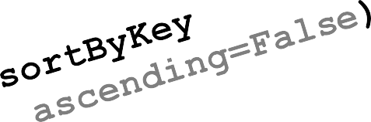



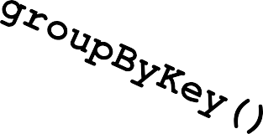

Example: Pair RDD Operations
(00004,sku411)
(00003,sku888)
(00003,sku022)
(00003,sku010)
(00003,sku594)
(00002,sku912)
…
(00001,sku010) (00001,sku933) (00001,sku022) (00002,sku912) (00002,sku331) (00003,sku888)
…
(00002,[sku912,sku331]) (00001,[sku022,sku010,sku933]) (00003,[sku888,sku022,sku010,sku594]) (00004,[sku411])
14-30

Slide 135









Example: Joiningby Key
> movies = moviegross.join(movieyear)
RDD: moviegross
RDD: movieyear
(Casablanca,$3.7M) (Casablanca,1942) (Star Wars,$775M) (Star Wars,1977)
(Annie Hall,$38M) (Annie Hall,1977)
(Argo,$232M) (Argo,2012)
… …
(Casablanca,($3.7M,1942)) (Star Wars,($775M,1977)) (Annie Hall,($38M,1977)) (Argo,($232M,2012))
…

Slide 136
Using Join
A common programming pattern
Map separate datasets into key-value Pair RDDs
Join by key
Map joined data into the desired format
Save, display, or continue processing…

Slide 137








Example: Join Web Log With Knowledge Base Articles (1)
weblogs
56.38.234.188 – | 99788 | "GET | /KBDOC-00157.html HTTP/1.0" …
56.38.234.188 – | 99788 | "GET | /theme.css HTTP/1.0" …
203.146.17.59 – | 25254 | "GET | /KBDOC-00230.html HTTP/1.0" …
221.78.60.155 – | 45402 | "GET | /titanic_4000_sales.html HTTP/1.0" …
65.187.255.81 – … | 14242 | "GET | /KBDOC-00107.html HTTP/1.0" …
User ID
Requested File
join
kblist
KBDOC-00157:Ronin Novelty Note 3 - Back up files KBDOC-00230:Sorrento F33L - Transfer Contacts KBDOC-00050:Titanic 1000 - Transfer Contacts KBDOC-00107:MeeToo 5.0 - Transfer Contacts KBDOC-00300:iFruit 5A – overheats
…
Article ID
Article Title

Slide 138
Example: Join Web Log With Knowledge Base Articles (2)
Steps
1.
Map separate datasets into key-value Pair RDDs
Map web log requests to (docid,userid)
Map KB Doc index to (docid,title)
Join by key: docid
Map joined data into the desired format: (userid,title)
Further processing: group titles by User ID

Slide 139






Step 1a: Map Web Log Requests to (docid,userid)
 | Language: Python
> import re > def getRequestDoc(s): return re.search(r'KBDOC-[0-9]*',s).group() > kbreqs = sc.textFile(logfile) \ .filter(lambda line: 'KBDOC-' in line) \ .map(lambda line: (getRequestDoc(line),line.split(' ')[2])) \ .distinct()
56.38.234.188 | – 99788 | "GET | /KBDOC-00157.html HTTP/1.0" …
56.38.234.188 | – 99788 | "GET | /theme.css HTTP/1.0" …
203.146.17.59 | – 25254 | "GET | /KBDOC-00230.html HTTP/1.0" …
221.78.60.155 | – 45402 | "GET | /titanic_4000_sales.html _{kbreq}
65.187.255.81 | – 14242 | "GET | /KBDOC-00107.html HTTP/1
… |  |  | (KBD
HTTP/1.0"
.0" …
…
s
OC-00157,99788) (KBDOC-00203,25254) (KBDOC-00107,14242)
…

Slide 140






Step 1b: Map KB Index to (docid,title)
 | Language: Python
> kblist = sc.textFile(kblistfile) \ .map(lambda line: line.split(':')) \ .map(lambda fields: (fields[0],fields[1]))
KBDOC-00157:Ronin Novelty Note 3 - Back up files KBDOC-00230:Sorrento F33L - Transfer Contacts
KBDOC-00050:Titanic KBDOC-00107:MeeToo KBDOC-00206:iFruit
…
1000 - Transfer Contacts
5.0 - Transfer Contacts 5A – overheats
kblist
(KBDOC-00157,Ronin Novelty Note 3 - Back up files) (KBDOC-00230,Sorrento F33L - Transfer Contacts) (KBDOC-00050,Titanic 1000 - Transfer Contacts) (KBDOC-00107,MeeToo 5.0 - Transfer Contacts)
…

Slide 141









Step 2: Join By Key docid
Language: Python
> titlereqs =
kbreqs.join(kblist)
kbreqs
kblist
(KBDOC-00157,99788)
(KBDOC-00157,Ronin Novelty Note 3 - Back up files) (KBDOC-00230,Sorrento F33L - Transfer Contacts) (KBDOC-00050,Titanic 1000 - Transfer Contacts) (KBDOC-00107,MeeToo 5.0 - Transfer Contacts)
(KBDOC-00230,25254)
(KBDOC-00107,14242)
…
…
(KBDOC-00157,(99788,Ronin Novelty Note 3 - Back up files)) (KBDOC-00230,(25254,Sorrento F33L - Transfer Contacts)) (KBDOC-00107,(14242,MeeToo 5.0 - Transfer Contacts))
…

Slide 142





Step 3: Map Result to Desired Format (userid,title)
Language: Python
> titlereqs = kbreqs.join(kblist) \
.map(lambda (docid,(userid,title)): (userid,title))
(KBDOC-00157,(99788,Ronin Novelty Note 3 - Back up files))
(KBDOC-00230,(25254,Sorrento F33L - Transfer Contacts)) (KBDOC-00107,(14242,MeeToo 5.0 - Transfer Contacts))
…
(99788,Ronin
Novelty Note 3 - Back up files)
(25254,Sorrento F33L - Transfer Contacts) (14242,MeeToo 5.0 - Transfer Contacts)
…

Slide 143








Step 4: Continue Processing – Group Titles by User ID
Language: Python
> titlereqs = kbreqs.join(kblist) \
.map(lambda (docid,(userid,title)): (userid,title)) \
.groupByKey()
(99788,Ronin Novelty Note 3 - Back up files) (25254,Sorrento F33L - Transfer Contacts) (14242,MeeToo 5.0 - Transfer Contacts)
…
(99788,[Ronin Novelty Note 3 - Back up files, Ronin S3 - overheating])
(25254,[Sorrento F33L - Transfer Contacts])
(14242,[MeeToo 5.0 - Transfer Contacts, MeeToo 5.1 - Back up files, iFruit 1 - Back up files, MeeToo 3.1 - Transfer Contacts])
…
Note: values are grouped into Iterables

Slide 144



Example Output
Language: Python
> for (userid,titles) in titlereqs.take(10): print 'user id: ',userid
for title in titles: print '\t',title
user id: 99788
Ronin Novelty Note 3 - Back up files
Ronin S3 – overheating user id: 25254
Sorrento F33L - Transfer Cont user id: 14242
MeeToo 5.0 - Transfer Contacts
(99788,[Ronin Novelty Note 3 - Back up files,
Ronin S3 - overheating])
acts
(25254,[Sorrento F33L - Transfer Contacts])
(14242,[MeeToo 5.0 - Transfer Contacts,
MeeToo 5.1 - Back up files, iFruit 1 - Back up files, MeeToo 3.1 - Transfer Contacts])
MeeToo 5.1 - Back up files iFruit 1 - Back up files
…
MeeToo 3.1 - Transfer Contacts
…
14-40

Slide 145








Aside: Anonymous Function Parameters
Python and Scala pattern matching can help improve code readability
> map(lambda (docid,(userid,title)): (userid,title))
Python
> map(pair => (pair._2._1,pair._2._2))
Scala
OR
> map{case (docid,(userid,title)) => (userid,title)}
(KBDOC-00157,(99788,…title…)) (KBDOC-00230,(25254,…title…)) (KBDOC-00107,(14242,…title…))
…
(99788,…title…)
(25254,…title…)
(14242,…title…)
…

Slide 146
Other Pair Operations
Some other pair operations
keys – return an RDD of just the keys, without the values
values – return an RDD of just the values, without keys
lookup(key) – return the value(s) for a key
leftOuterJoin, rightOuterJoin , fullOuterJoin – join, including keys defined in the left, right or either RDD respectively
mapValues, flatMapValues – execute a function on just the values, keeping the key the same
See the PairRDDFunctions class Scaladoc for a full list

Slide 147
Chapter Topics
Aggregating Data with Pair RDDs
Key-Value Pair RDDs
Map-Reduce
Other Pair RDD Operations
Essential Points
Hands-On Exercise: Use Pair RDDs to Join Two Datasets

Slide 148
Essential Points
Pair RDDs are a special form of RDD consisting of Key-Value pairs (tuples)
Spark provides several operations for working with Pair RDDs
Map-reduce is a generic programming model for distributed processing
Spark implements map-reduce with Pair RDDs
Hadoop MapReduce and other implementations are limited to a single map and single reduce phase per job
Spark allows flexible chaining of map and reduce operations
Spark provides operationsto perform easily common map-reduce algorithms like joining, sorting, and grouping

Slide 149
Chapter Topics
Aggregating Data with Pair RDDs
Key-Value Pair RDDs
Map-Reduce
Other Pair RDD Operations
Essential Points
Hands-On Exercise: Use Pair RDDs to Join Two Datasets

Slide 150
Hands-On Exercise: Use Pair RDDs to Join Two Datasets
In this exercise you will
Continue exploring web server log files using key-value Pair RDDs
Join log data with user account data
Please refer to the Hands-On Exercise Manual

